Slide 1
Human Capital Office
New Hire Orientation
Payroll and Personnel Systems
1
Notes:
Welcome to the New Hire Orientation presented by HR Shared Services, Payroll, Benefits, and Personnel Systems.
In today’s presentation, you will be provided with a lot of information in a short period of time, so please pay close attention and write down any questions you may have.

Slide 2
Resources
On-line access via the intranet with the IRS Source Website
OS GetServices, the online self-service ticketing tool for problems with computers, phones, workspace and other support issues
Online training, travel guidance, and NFC Employee Personal Page among many others
Reference sites such as the Internal Revenue Manual (IRM), Westlaw, and Lexis/Nexis
Telephone access at 1-866-743-5748 Option 1, then Option 3.
2
Notes:
When logging into your computer, the Intranet page that should come up is IRS Source. You will find numerous programs on this page, as well as, some specific to your Business Unit. OS GetServices is an online self-service ticketing tool only accessible through the intranet. You use this tool for creating tickets for items such as phones, computers, workspace, security, etc. We also encourage you to open OS GetServices tickets, as opposed to calling the Customer Service Line at the Employee Resource Center (ERC), due to excessive wait times. IRS Source also has travel guidance, online training, reference sites, the Employee Personal Page (EPP) and many others. If you cannot find what you need through these sources you should contact the Customer Service Line at ERC at 866-743-5748 option 1, option 3, then listen to the prompts for the correct area.

Slide 3
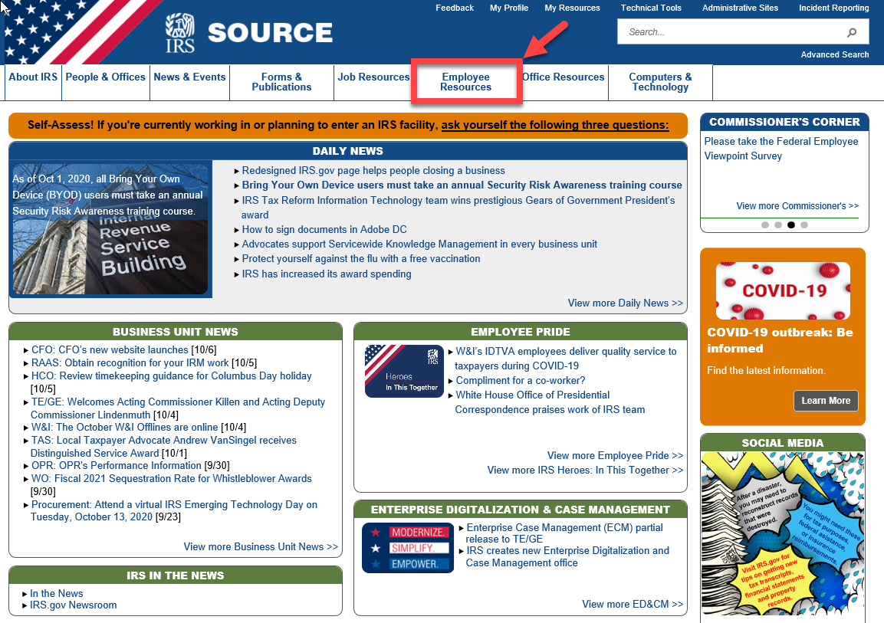
IRS Source Homepage
3
Notes:
When on the IRS Source Homepage, select Employee Resources to find a listing of items pertaining to Benefits, Pay, Retirement, and much more. Once you select Employee Resources, a drop down menu will appear.

Slide 4
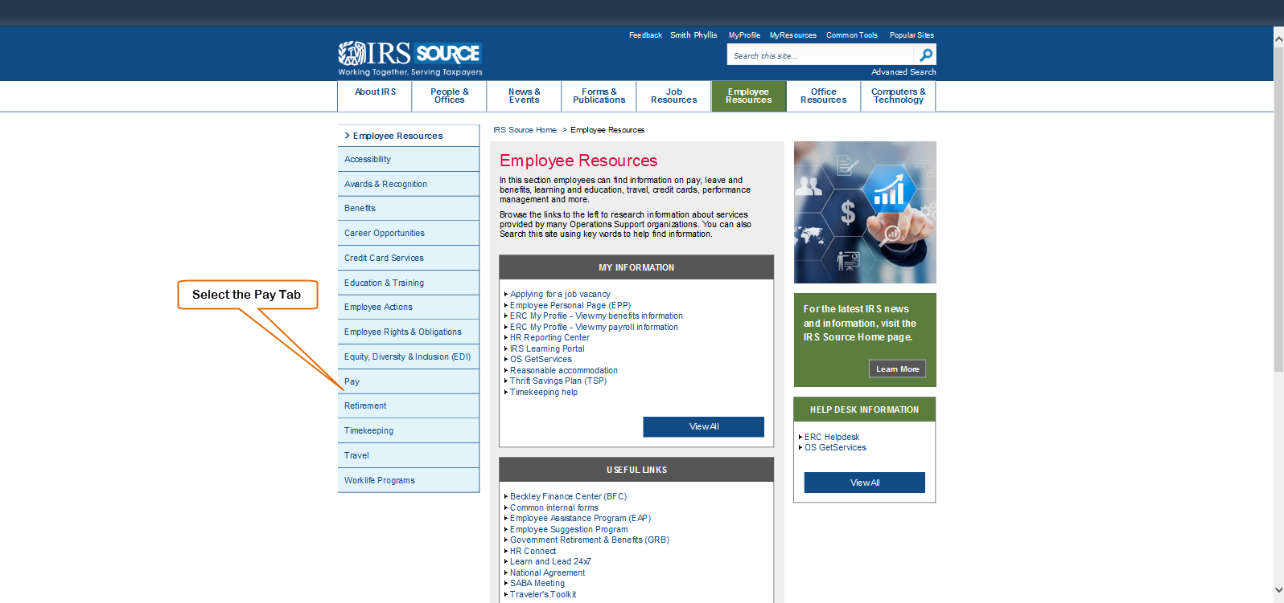
Locating Information
4
Notes:
One of the most important, if not the most important benefits as an IRS is our pay. From the left side menu, select Pay, and another screen will appear.

Slide 5
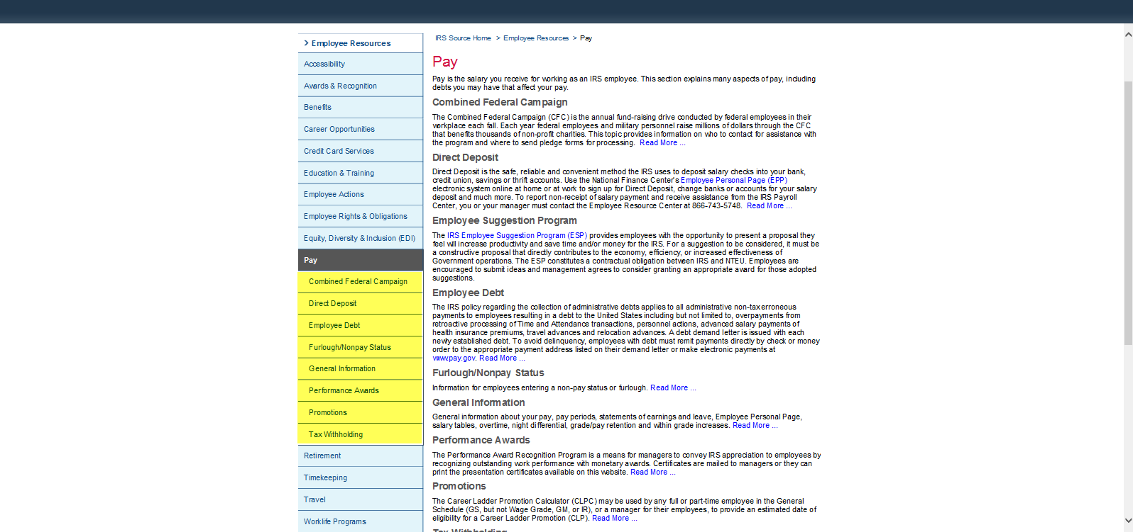
Identifying a Topic
When you select a specific tab, a list of topics within that subject will appear.
5
Notes:
Under the Pay tab, there are additional topics like: Combined Federal Campaign (CFC). This campaign is held once a year and your area will have numerous announcements about it throughout the campaign. You also will see options for the Employee Suggestion Program, Furlough/Non-pay Status, Tax Withholding, just to name a few. Performance Awards are based on your annual performance and manager approval. Furlough/Non-Pay Status can be discussed more with your manager. Employee Debt can be as a result of non-pay status, salary overpayments, and other reasons.

Slide 6
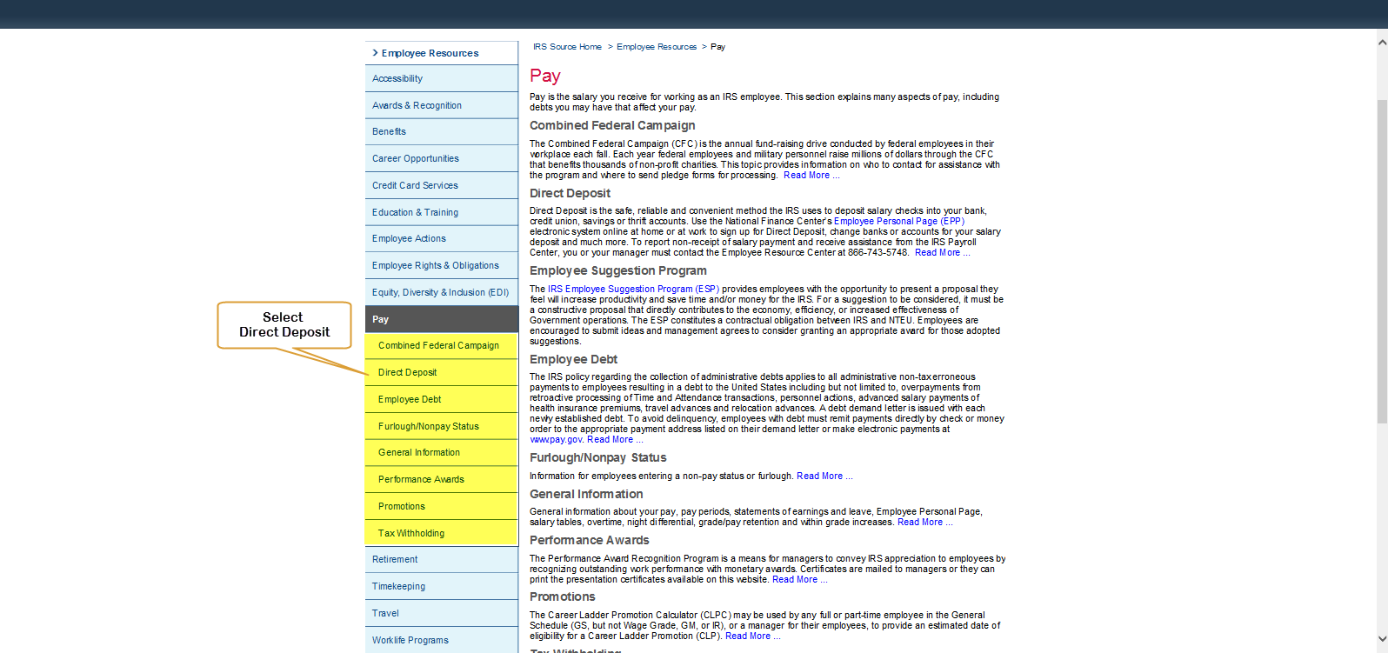
Narrowing Topic Choices
You can continue to research the topics as needed
6
Notes:
Still on the left side menu, select Direct Deposit to be routed to a more detailed description of this tab.

Slide 7
Continue to Narrow Topic Choices
7
Notes:
Under the Direct Deposit topic, there are several selections. We are focused on the Direct Deposit of Salary Check.

Slide 8
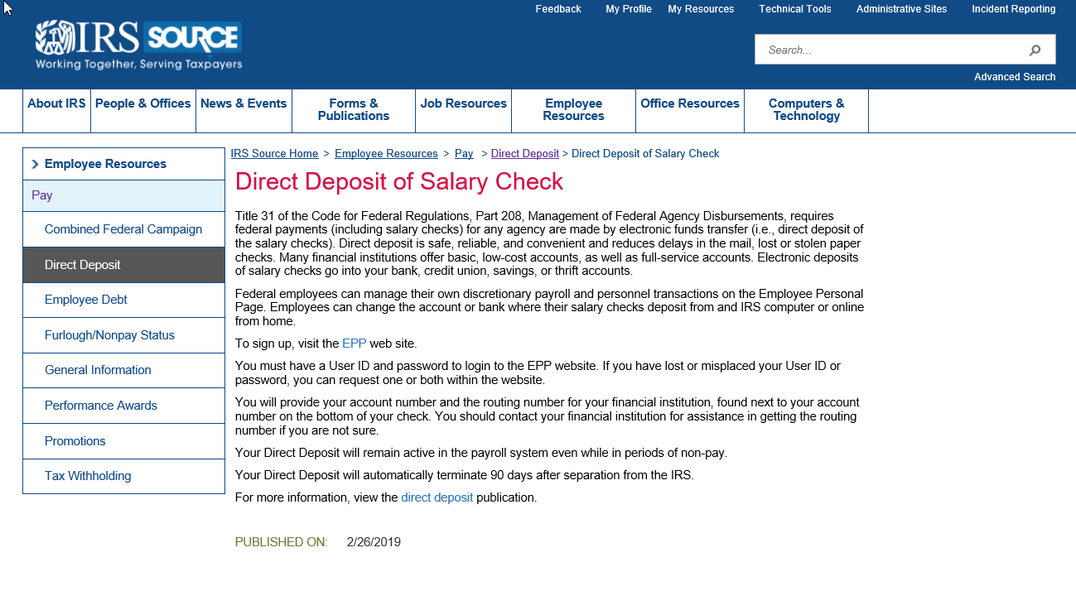
Locating the Answer
In this example, you will find specific information on Direct Deposit of Salary Checks.
8
Notes:
Under Title 31 of the Code of Federal Regulations, Part 208, Management of Federal Agency Disbursements, requires federal payments, including salary checks, for any agency, be made via electronic funds transfer. You can only have one direct deposit account for your payroll check; however, you can set up allotments for funds to be distributed. You likely provided your direct deposit information through the onboarding process; however, if you are unsure, or you didn’t provide it during the onboarding process, contact the Ogden Payroll Center through the Customer Assistance Line at ERC. Once you receive your first paycheck, you will be able to log into the Employee Personal Page to make any changes to your Direct Deposit. We will discuss the Employee Personal Page later in this presentation.

Slide 9
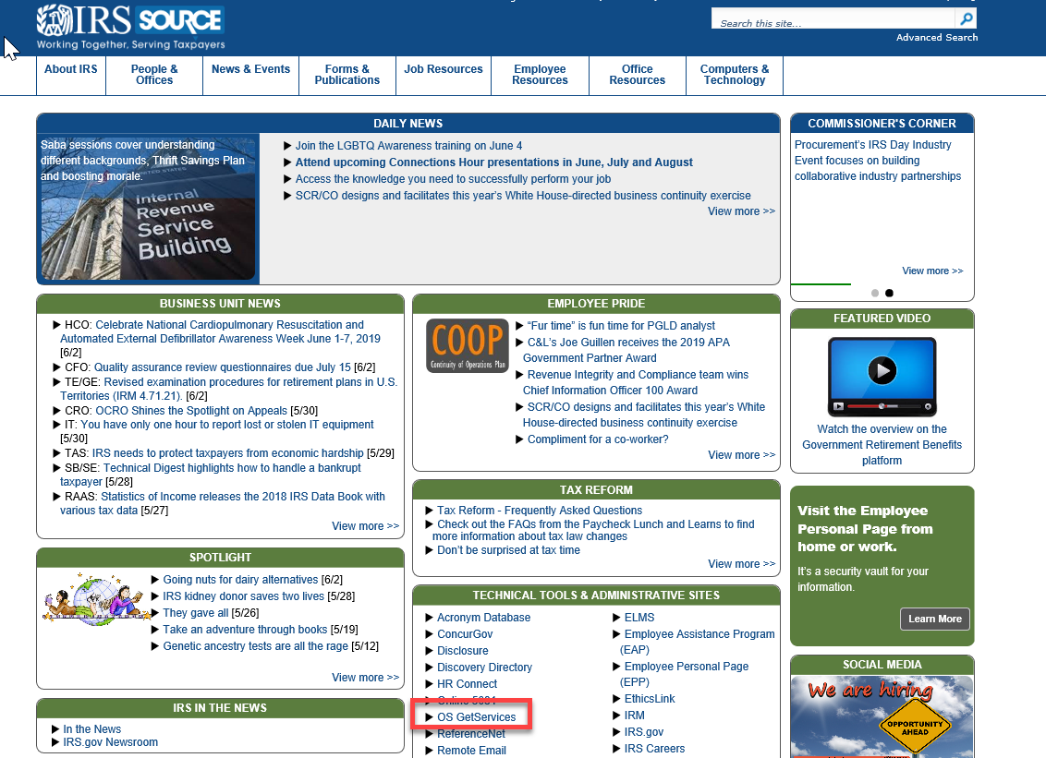
Links
9
Notes:
As stated earlier, there are many links to many systems on IRS Source. Another one that is used often, and was briefly mentioned earlier, is OS GetServices. You can use this tool 24/7 from any IRS computer/intranet but it can not accessed from a home computer.

Slide 10
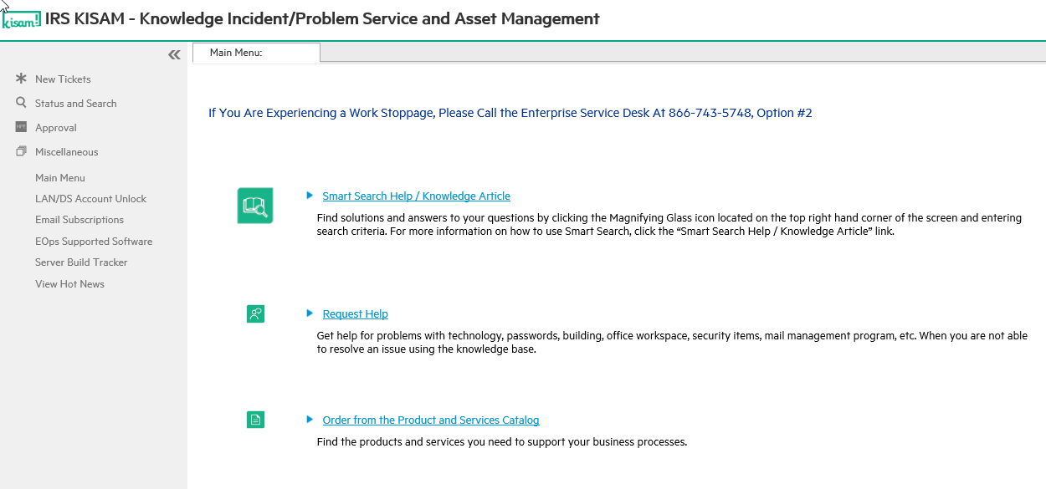
Example: OS GetServices
Use OS GetServices to submit tickets for services and repairs.
10
Notes:
Once in OS GetServices, you will choose the applicable link depending on the service you need. For example, Pay and Timekeeping, Salary Problems would be under Order From the Products and Services Catalog, Employee Lifecycle Services. This is a system you can learn more about on ITM.

Slide 11
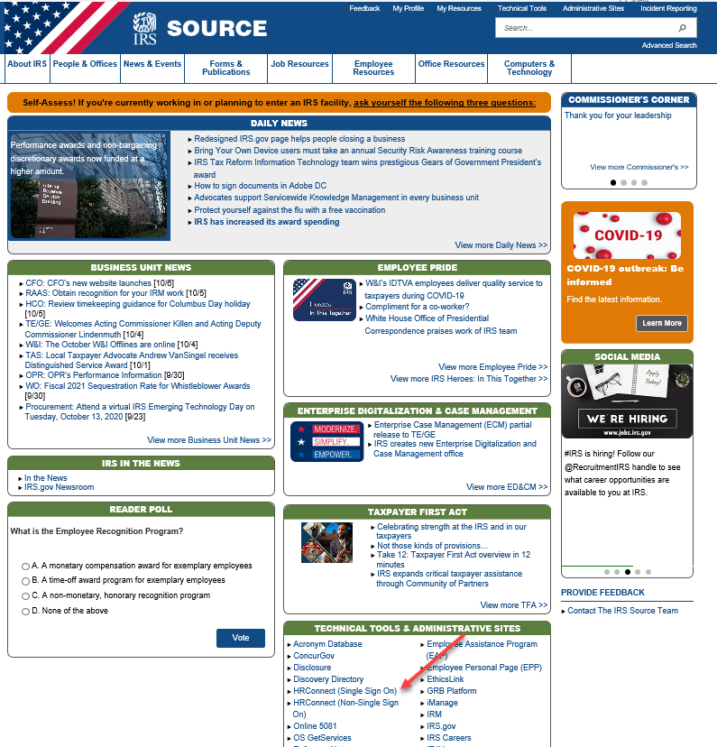
Links
11
Notes:
Another useful link available for your use, on the IRS Source page, is HR Connect. This is a tool used for updating your name, and/or address, viewing performance award/bonus information, as well as, where your evaluations are housed for 5 years. Your manager will be able to help you gain access to the HR Connect site, as well as log in. If they can not, you can contact the Employee Resource Center Customer Assistance Line.

Slide 12
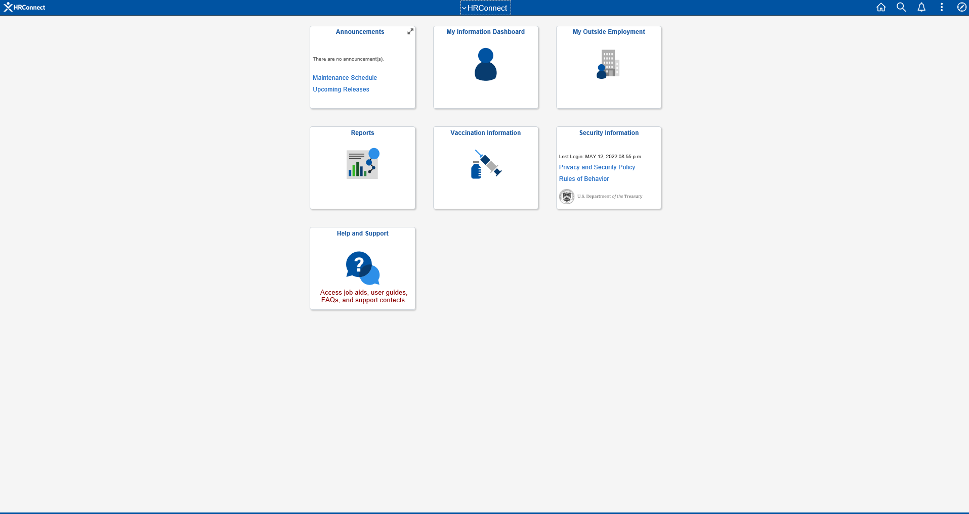
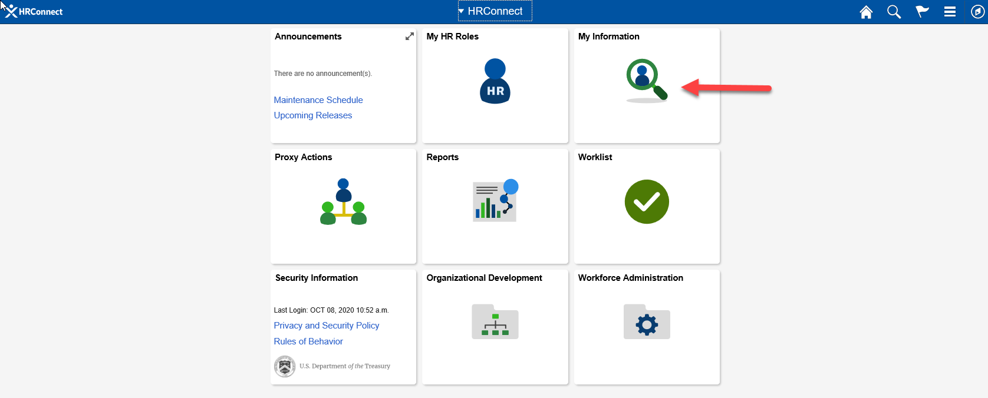
Information on HRConnect
Use HR Connect to keep your personal and emergency contact information current.
12
Notes:
Once registered and logged in, you will go to the My Information tab.

Slide 13
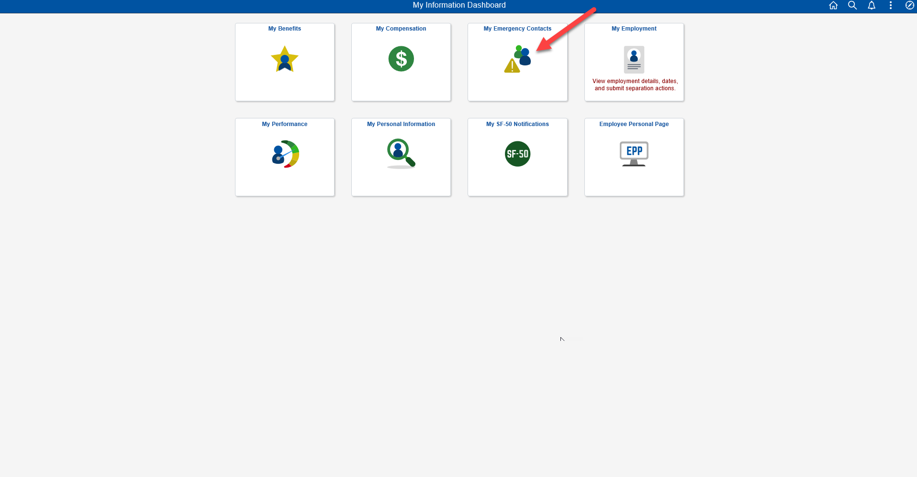
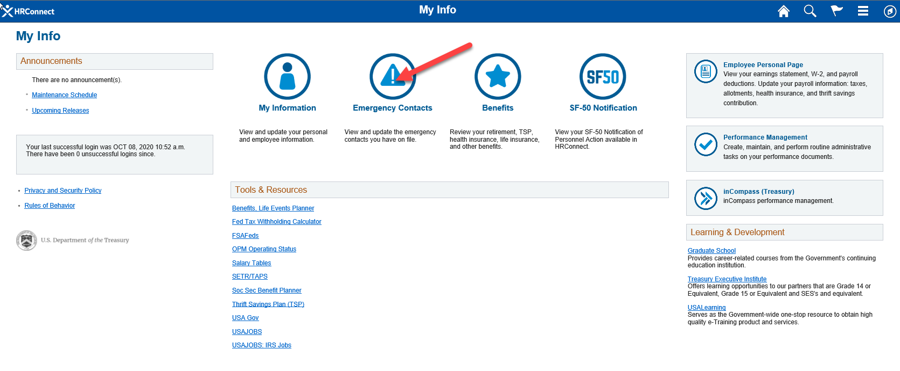
Information on HRConnect
Use HR Connect to keep your personal and emergency contact information current.
13
Notes:
Here you need to add your emergency contact information as soon as possible. This is how your management team would contact you or someone you identify in case of an emergency at work.

Slide 14
Human Capital Office
Payroll and Benefits
14
Notes:
These next slides are very important, so pay very close attention.

Slide 15
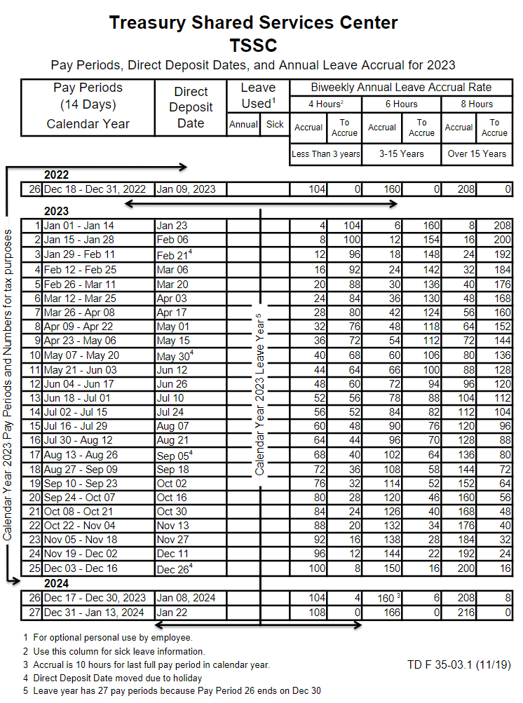
Pay Day
15
Notes:
Direct Deposit payments are the Monday following the completion of the Payroll process, or Tuesday for those pay periods when Monday is an official Federal holiday. This early posting to personal bank accounts is a courtesy by some, but NOT all financial institutions, as they are not obligated to post funds earlier than the actual payment date. The official pay days are every other Thursday.

Slide 16
Annual Leave / Sick Leave
As a new employee, your annual and sick leave are accrued at 4 hours per pay period. (Exception: If you have previous creditable civilian or military service or are part time.)
If you are transferring from another federal agency to the Internal Revenue Service, you may submit a copy of your last Statement of Earnings and Leave, to expedite the transfer of your leave balances and insurance:
Data Integrity/OPF Consolidation Site
Fax: 855-875-6605 or
Email: opf.con.site@irs.gov
16
Notes:
New employees accrue annual and sick leave at a rate of 4 hours per pay period. If you have prior creditable civilian or military service, or you are part time, your annual leave accrual may be different.
If you are transferring from another agency, you can submit your last statement of earnings and leave from your prior agency to expedite the transfer of your leave and health insurance. Expedited service can still take several pay periods, so please be patient.

Slide 17
Paid Parental Leave
The President signed the National Defense Authorization Act (NDAA) for Fiscal Year 2020 into law on December 20, 2019. The NDAA provides 12 weeks (up to 480 hours) of paid parental leave (PPL) for the birth, adoption or foster care placement of a child occurring October 1, 2020, or later, for employees covered by the Family and Medical Leave Act (FMLA), regardless of gender.
Employees are eligible for PPL if they have 12 months of covered, consecutive or non-consecutive federal service, if the federal service was covered under the Title 5 FMLA provision.
Timekeeping - Paid Parental Leave ( PPL) (irs.gov)
17
Notes:
The National Defense Authorization Act (NDDA) provides 12 weeks (480 hours) of Paid Parental Leave for the birth, adoption or foster care placement of a child occurring October 1, 2020, or later, for employees covered by the Family and Medical Leave Act (FMLA) regardless of gender. Employees are eligible for PPL if they have 12 months of covered, consecutive or non-consecutive federal service, if the federal service was covered under the Title 5 FMLA provision.

Slide 18
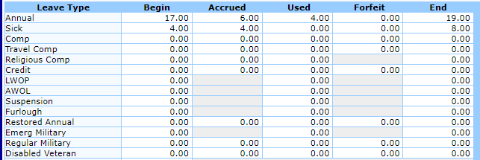
Wounded Warrior Federal Leave Act
The Wounded Warrior Federal Leave Act of 2015 provides a one-time entitlement for newly hired federal employees, hired on or after Nov 5, 2016, who are veterans with a qualifying service-connected disability rated at 30% or greater, to undergo medical treatment for such disability for which sick leave could regularly be used. Disabled Veteran Leave may not exceed 104 hours for a full-time employee and will be prorated for employees with part-time tours of duty (TOD).
This leave is automatically credited for veterans who have been properly coded as having a service-connected disability rating of 30% or greater.
Review your SETR leave balances to verify you have been properly credited for Disabled Veteran Leave.
For eligibility criteria and policy guidance, refer to:
Disabled Veteran Leave (opm.gov)
18
Notes:
This leave is automatically credited during the onboarding process if the veteran provided the Veterans Benefits Administration (VBA) certification of the qualifying service-connected disability rated at 30% or greater. If the Disabled Veteran Leave was not credited, the employee must submit an OS Get Services ticket along with the VBA certification documentation.
* If the employee has not been properly credited for Disabled Veteran Leave, they must submit an OS Get Services Ticket along with the supporting documentation (VA Benefits Letter).

Slide 19
Statements of Earnings & Leave (Pay Stub)
Review your Statement of Earnings & Leave (SEL) each pay day to ensure your pay, deductions and leave information is correct
Access your statement on the Employee Personal Page (EPP).
19
Notes:
It is a good practice, as well as your responsibility, to review your statement of earnings and leave after each pay date to ensure no errors were made during the input of your time by you, the timekeeper, management, etc. You want to ensure proper taxes are withheld, as it is your responsibility to be tax compliant. You can access this information through the Employee Personal Page (My EPP), which we will discuss later in this presentation. Your Statement of Earnings & Leave will be posted on your Employee Personal Page the Monday of payday.

Slide 20
Employee Personal Page (EPP)
All IRS employees are automatically signed up for My EPP when they are hired. EPP is a convenient “One-stop shop” that is available 24/7 from any computer with internet capabilities, which means you can access from Home or Work. EPP gives you the ability to review or change:
Earning and Leave Statements (Pay Stub)
W-2’s
Direct deposit information
Federal Healthcare insurance (FEHB) enrollment
Qualifying life event changes to your healthcare information
Health savings (FSA) allotments
Federal and State tax withholding allowances
Personal address information
Thrift Savings Plan and “catch-up” elections
Annual Personal Benefits Statements
20
Notes:
The Employee Personal Page (EPP) is a “One-stop shop” available 24/7 from any computer/smartphone/tablet with internet capabilities. You can access this information from home or work. You can review your statement of earnings and leave, W-2’s and annual Personal Benefits Statements. You can also review and change other deductions, such as FEHB enrollment (based on a Qualifying Life Event (QLE) or Open Season, Allotments, Federal and State tax withholdings and many others.

Slide 21
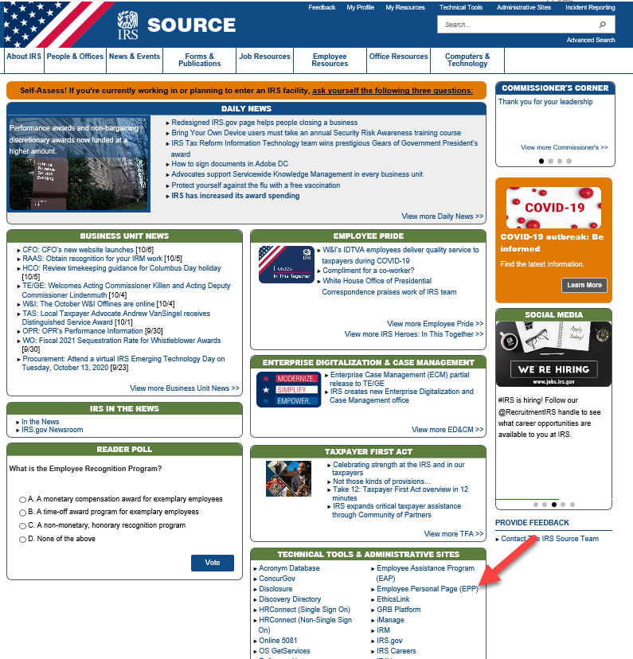
Accessing EPP from IRS Source
21
Notes:
To access the EPP from work, go to the IRS Source home page, scroll to the Technical Tools & Administrative Sites banner and select Employee Personal Page.

Slide 22
Accessing EPP from Home
To access My EPP from home, visit the National Finance Center’s home page on the internet by going to https://www.nfc.usda.gov.
Select “Applications”
22
Notes:
To access from home, go to https://www.nfc.usda.gov. Select Applications.

Slide 23
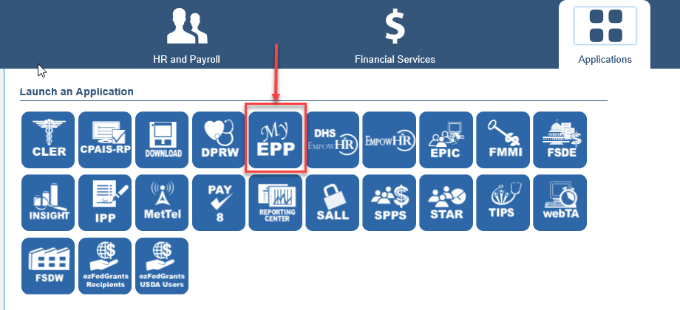
Accessing EPP from Home
From the drop-down menu select “My EPP”
23
Notes:
From the drop-down menu select My EPP

Slide 24
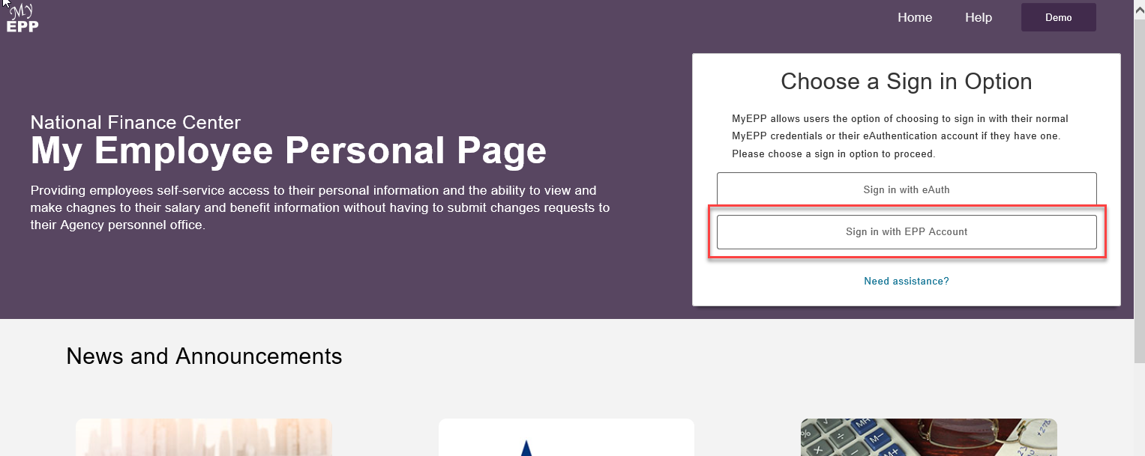
Accessing EPP
To continue the EPP Login Page select “I Agree”.
You will be directed to the EPP Login Page.
24
Notes:
From the Login page you will select: Sign in with EPP Account

Slide 25
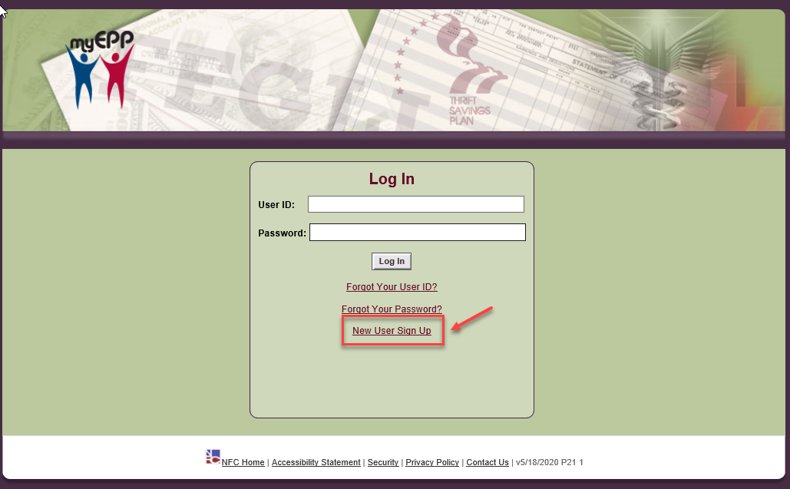
Accessing EPP
You will be directed to the EPP Login Page.
Here you will select, “New User Sign-Up”
25
Notes:
To gain access to the EPP, you must register. From the Login screen, you will select the New User Sign Up link

Slide 26
New Employee Accessing EPP for first time
EPP will not be available to you until you have completed and been paid for your first pay period with the agency.
If you have been issued an IRS Work Email
Select “New User Sign-Up”
Enter your Social Security Number (no dashes) and your date of birth (mm/dd/yyyy), select continue
Enter your IRS Work email address in both fields select “Sign-Up”
If you have NOT or will NOT be issued an IRS Work Email
Contact ERC at 866-743-5748 Options 1 and 1 again and request your SPO PIN.
From the EPP Login screen select “New User Sign-Up”
Enter your Social Security Number (no dashes) and your date of birth (mm/dd/yyyy), select continue
Select, “No Work Email Address”
Enter the SPO PIN given to you by Payroll, select continue
Enter your personal email address in both fields, select “Sign-Up”
In both cases, the temporary password will be emailed to the email address you entered. When you receive it, go to the EPP login page. Input your Social Security Number (no dashes) for your User ID and the temporary password in the password field.
26
Notes:
As a new employee, you won’t be able to access EPP until after you receive your first salary check. Once you have received your first check, you will follow the instructions on this page to register and gain access to the EPP.

Slide 27
Transfer Employee Accessing EPP
If you are a transfer employee that previously had an EPP account, you will need to contact the Employee Resource Center and request that a Doc 444 be submitted to update your account with IRS information.
27
Notes:
If you are transferring from another agency where EPP was used, you need to contact Payroll via the Customer Assistance Line, at 866-743-5748 options 1, then 1 again. Inform the Payroll Representative you transferred from another agency who used EPP and you need a 444 document submitted to update your account with IRS information.

Slide 28
EPP Two-Step Authentication
EPP has a two-step authentication process to strengthen the security posture regarding employee’s information.
You will be asked to authenticate each time you log into EPP.
28
Notes:
As an added layer of security, EPP has a two-step authentication process you’ll be asked to complete at each login.

Slide 29
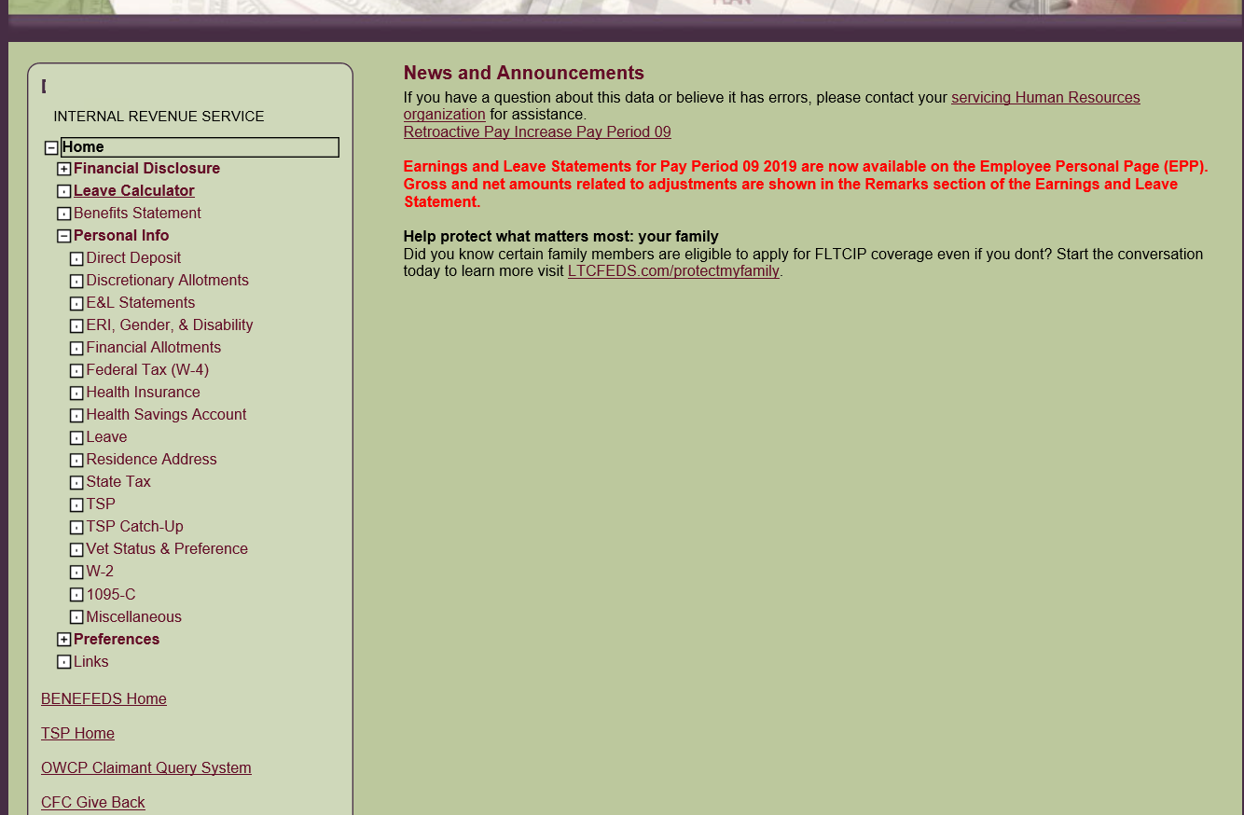
EPP Menu Home Page
When successfully logged into EPP, you’ll see a list of payroll topics. To make changes or view statements select a topic
29
Notes:
Once logged in, you will see a menu of options regarding your pay and benefits.

Slide 30
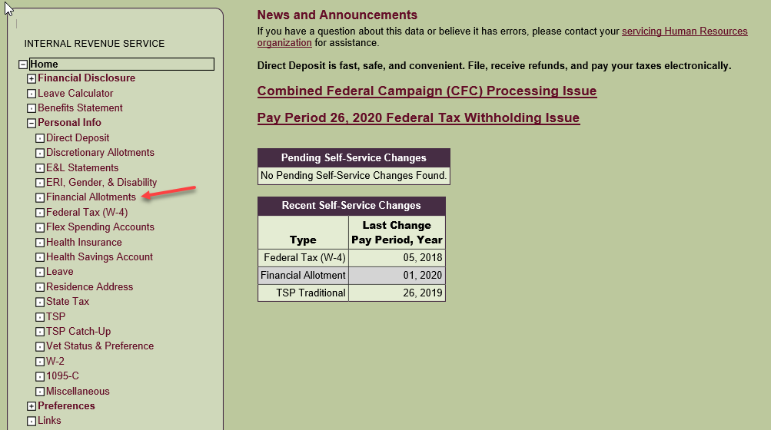
Making EPP Changes
To make a change, select any option from the menu
30
Notes:
To make a change, select an option from the menu. In this example, we are using the Financial Allotment.

Slide 31
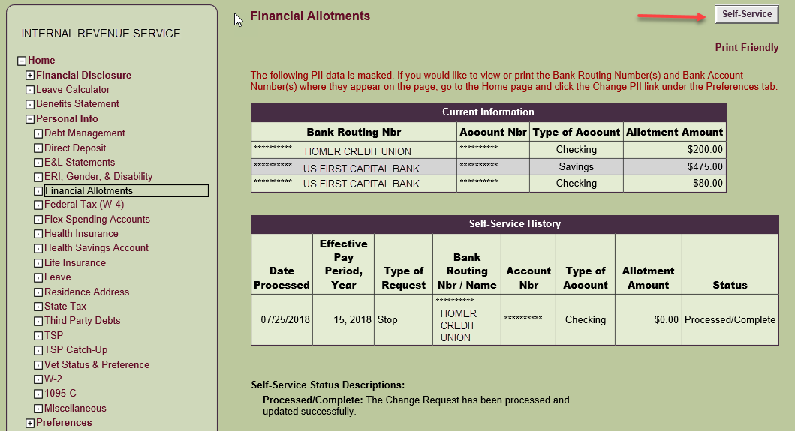
Making EPP Changes
Select the Self-Service tab, and follow the prompts on the upcoming screens
31
Notes:
Once the window for the option you’ve chosen opens, select the gray “Self Service” icon in the upper right corner, then complete your change. Make sure to select submit. You will receive a confirmation email once you submit your change.

Slide 32
Employee Self Help Tools
You will receive multiple passwords and/or Personal Identification Numbers (PIN) by email or mail. Each one is specific to a particular system that enables you to perform payroll or personnel related transactions
DO NOT LOSE THEM!
32
Notes:
As a new employee, you will receive a lot of information in a short amount of time. You will also receive numerous Personal Identification Numbers (PIN) via email or personal mail for different systems. Each PIN is unique to an individual system, so do not lose them.

Slide 33
Seasonal Employees – Full or Part Time Health and Life Insurance
Federal Employee Health Benefit (FEHB) Eligibility: Seasonal employees who work six months or more during the current season/year and are expected to work six months or more during each subsequent year can be certified for both Health (FEHB) and Life (FEGLI) insurance. Full-time seasonal employees will receive the same government contribution as full-time permanent employees. Part-Time seasonal employees are covered under the Part-time Career Act and will have their FEHB premium prorated based on the number of hours they work. (Note: employees may only be certified for FEHB once per appointment).
Federal Employee Group Life Insurance (FEGLI) Eligibility: Generally, basic life insurance is automatic if you have a permanent appointment or convert to a permanent appointment, are a permanent, part-time employee, or are in a position with Federal retirement coverage, or are on a temporary appointment exceeding one year.
33
Notes:
Seasonal Employees are employees who work six months or more during the current season or year AND are expected to work six months or more during each subsequent year. If this is you, you can be certified for both Health insurance and Life insurance. Full-time seasonal employees receive the same government contribution for Federal Employees Health Benefits (FEHB) as full-time permanent employees. Part-time seasonal employees are covered under the Part-time Career Act and will have their FEHB premium prorated based on the number of hours in their part time tour of duty. Employees may only be certified for FEHB once per appointment. For Federal Employees Group Life Insurance (FEGLI); Basic life insurance is generally automatic if you have a career conditional appointment or convert to a career appointment, you are a permanent, part-time employee, you are in a position with Federal retirement coverage, or you are on a temporary appointment exceeding one year.

Slide 34
Health and Life Insurance
Forms SF-2809 for health insurance and SF-2817 for life insurance should be completed through the USA Staffing system.
You have up to 60 days to make an election and submit through the USA Staffing system. If possible, you should also upload your verification documentation for all eligible family members.
If you are unable to load your verification documents through USA Staffing you can email them to Ogden.Benefits.Section@irs.gov. You can fax to 855-816-9805 if email is currently unavailable to you.
34
Notes:
FEHB (SF-2809), and FEGLI (SF-2817), forms should be completed and submitted through the USA Staffing system. You have up to 60 days to make an election and submit through USA Staffing. Keep in mind the sooner you submit your forms, the sooner your insurance will be effective. If you are unable to provide your verification documents through USA Staffing, you can email them to Ogden.Benefits.Section@irs.gov. If email is not available to you, you can fax your documents to 855-816-9805. While you have up to 60 days so submit verification of eligible family members, please don’t wait and risk not having coverage for your family.

Slide 35
3
Acceptable Documentation To Verify Eligibility
Spouse | Married less than 12 months: copy of government-issued marriage certificate. Married 12 months or more: copy of government-issued marriage certificate and one of the following sets of documents listing spouse Front page of most recent tax year’s Federal or State tax return; or Proof of common residency (e.g., utility bill, other household bill, auto registration); and proof of financial interdependency (e.g., shared bank statement, credit card statement, life or auto insurance policy). Common law marriage: Declaration of Common Law Marriage.
Child under age 26 | A copy of any one of the following documents listing child and enrollee: Government-issued birth certificate; or Certificate of live birth; or Front page of the most recent tax year’s Federal or State tax return; or Consular Report of Birth Abroad; or Official paternity test; or Voluntary affidavit of paternity or similar document; or Court or administrative order (e.g., National Medical Support Notice).
Adopted Child under age 26 | A copy of any one of the following documents listing child and enrollee: Final adoption certificate or decree; or Authorized letter from a placement agency for the purpose of adoption; or Front page of most recent tax year’s Federal or State tax return with the child’s name; or Court or administrative order (e.g., National Medical Support Notice).
Stepchild under age 26 | A copy of any one of the following documents: Birth Certificate, or final adoption certificate/decree, listing current spouse as parent; or Front page of most recent tax year’s Federal or State tax return with child’s name or Court or administrative order (e.g., National Medical Support Notice). The enrollee must also verify a spouse’s eligibility (see above for required documents), even if not enrolling the spouse in an FEHB plan.
Notes:
The next two slides provide you with a list of acceptable documentation for verifying your eligible family members. If you cannot send your verification documents at the same time as your SF2809, you have up to 60 days to provide the information, but sending it in sooner than later will avoid any delays or gaps in coverage.

Slide 36
Acceptable Documentation To Verify Eligibility
Foster child under age 26 | Submit all of the following documents: Certification of foster child status. Government-issued birth certificate or other document verifying child’s date of birth. Documentation of regular and substantial support for the child, such as: Evidence of eligibility as a dependent child for benefits under other State or Federal programs; Proof of inclusion of the child as a dependent on the enrollee’s front page of most recent tax year’s Federal or State tax returns; Canceled checks, money orders, or receipts for periodic payments from the enrollee for or on behalf of the child; Evidence of good or services which show regular and substantial contributions of considerable value; If applicable, include copy of court order naming employee or spouse as child’s legal guardian.
Disabled child age 26 or older who is incapable of self-support because of a physical or mental disability that began before 26th birthday | Medical certificate stating the child is incapable of self-support because of a physical or mental disability that existed before he/she became age 26 and is expected to continue for more than one year. The enrollee must also verify the child’s eligibility (see above for required documents).

Slide 37
Federal Employee’s Health Benefits (FEHB)
Guaranteed coverage
No medical examination required
No restrictions for preexisting conditions
On average, the Government pays 75% of premiums
Pay premiums with pre-tax dollars
Continued coverage in retirement
37
Notes:
FEHB provides the following:
guaranteed coverage
no medical exam required
no restrictions for preexisting conditions
75% of the premium is paid by the government on average
you can pay premiums with pre-tax dollars
you can carry the coverage into retirement. There are stipulations on carrying into retirement, so make sure to listen for that information or contact your retirement specialist if this is of interest to you.

Slide 38
Federal Employee’s Health Benefits (FEHB)
Health benefits enrollment must be received within 60 days of EOD:
Coverage will begin the next pay period after receipt. It can take 30-60 days from the effective date of your enrollment to receive your policy number/insurance cards.
After you enroll, you can only change your health insurance during Open Season or with a Qualifying Life Event (QLE)
Visit http://www.opm.gov/insure for more information. This includes brochures for participating carriers
38
Notes:
Your health insurance enrollment must be received by Payroll within 60 days of your Enter on Duty date (EOD). Your coverage will begin the pay period after receipt of the form, if it doesn’t contain errors. It can take 30-60 days from the effective date of your enrollment to receive your policy number and insurance cards. After you enroll, you can only change your health insurance during Open Season, which runs from the second week in November through second week in December, or with a Qualifying Life Event (QLE). Qualifying life events include birth, death, marriage, divorce, loss of coverage or gaining other coverage, etc. Make sure to the plan name. This is the carrier you are choosing, for example, Aetna, Blue Cross Blue Shield, GEHA etc. The enrollment code, which is the 3-digit code of the plan of the carrier you choose. It may be three numbers or a mix of letters and numbers. You will find the enrollment code on OPM.gov next to the plan you choose. You can visit OPM.gov to research information regarding all the carriers and plans offered. You can compare plans using the Plan Comparison Tool found by hovering over the insurance tab and selecting the plan comparison tool. The tool allows you to compare up to three plans at a time.

Slide 39
Furlough/Non-Pay / Leave Without Pay (LWOP) impact on FEHB Coverage
The first time you go into non-pay or have insufficient pay you will receive a future election letter regarding your FEHB coverage.
Make sure to review and respond to any, and all, IRS correspondence you receive so your benefits are not impacted.
If you do not respond appropriately to future correspondence, you risk your FEHB insurance being terminated once you have been in a non-pay status for 365 days. The 365 days does not need to be continuous but may be broken by periods of pay status.
If your coverage has been terminated, you can re-enroll within 60 days after returning to duty. Then you must be in a pay status at least part of each pay period for four consecutive months (9 pay periods) or your insurance will be terminated with the next period of non-pay status.
If you are in a pay status for at least four consecutive months, the clock restarts for the 365 days of permissible continuation of coverage.
39
Notes:
Furlough, Non-Pay, or Leave Without Pay (LWOP) can impact your health insurance, as it can cause you to owe a debt to the Agency. When you go into non-pay status or insufficient pay you will receive an election letter for your FEHB coverage. This election letter asks you to choose whether to continue your health insurance coverage or to terminate, while in non-pay or insufficient pay status. If you choose to continue your coverage, you will remain covered, and the agency will pay your premiums while you are in the non-pay status, incurring a debt to the Agency. Once you return to pay status the premiums paid by the agency will be garnished from your pay until the debt is paid in full. If you choose to terminate coverage during non-pay, you will have an opportunity to re-enroll when you return to duty. If you are in a Non-Pay status for more that 365 days, your insurance will be terminated. The 365 days do not have to be continuous and may be broken into several periods of non-pay or furlough status. If your coverage has been terminated, you can re-enroll within 60 days after returning to duty. You must be in pay status for at least part of each pay period, for four consecutive months, or 9 pay periods, otherwise your insurance will be terminated with the next period of non-pay status. If you are in pay status for at least four consecutive months, the clock restarts the 365 days of permissible continuation of coverage. It is important you read and respond to ANYTHING you receive from IRS. If it is something you do not understand, call Payroll through the Customer Assistance Line for assistance.

Slide 40
Additional Health Care Benefits
The Federal Employees Dental and Vision Program (FEDVIP) www.benefeds.com
Flexible Spending Account (FSA) www.fsafeds.com
Enroll within 60 days of EOD
Enrollment is via the website and not associated with your health insurance enrollment (i.e., SF2809)
Visit https://www.opm.gov/healthcare-insurance/healthcare for more information to help with your decisions
40
Notes:
There are additional benefits offered to you, as an IRS employee; however, these are not benefits Payroll assists with. These are separate from you FEHB coverage and you need to contact the providers, individually, for assistance. The additional benefits available are Federal Employees Dental and Vision Program (FEDVIP), and Flexible Spending Account (FSA). You have 60 days from your Enter on Duty (EOD) to enroll in any of these benefits. You can find more information regarding their programs on their websites or by going to the Office of Personnel Management website.

Slide 41
Supplemental Coverage Dental & Vision
Supplemental dental & vision coverage are available for additional premiums
Enrollment is done online at www.Benefeds.com
There are enrollment limitations for seasonal employee working less than 6 months.
41
Notes:
The Federal Employees Dental and Vision Program (FEDVIP) is supplemental to your FEHB plan and require additional premiums. The enrollment for vision and dental is done online at www.Benefeds.com. There are enrollment limitations for seasonal employees working less than 6 months. Remember, this benefit requires you to correspond or speak with a Benefeds representative for more information.

Slide 42
Federal Employee’s Group Life Insurance (FEGLI)
Guaranteed coverage
No medical examination required if elected when first eligible
Term Insurance – No Cash Value
Four parts to FEGLI
Basic Life Insurance
Basic Insurance Amount (BIA) = Annual pay rounded up to the next higher thousand + $2,000
For example: Basic annual pay = $45,200 so BIA = $48,000
Annual pay increases – BIA also increases
Cost is 16 cents for each $1,000 BIA coverage (48 X 16 = $7.68 per pay period)
Option A, Standard
$10,000 of coverage
Premiums based on age
42
Notes:
Federal Employees Group Life Insurance – FEGLI offers:
guaranteed Basic coverage unless you send in the Form 2817 to waive your coverage or choose additional coverage.
no medical exam
a term insurance plan, meaning there is no cash value
There are four basic parts to FEGLI coverage:
Basic Life Insurance; the coverage is equal to your annual pay rounded to the next higher thousand PLUS $2000, called you Basic Insurance Amount (BIA). Example: if your annual salary is $45,200, your BIA would be $48,000. Basic Life insurance costs is $.15 per $1,000 BIA coverage. Your BIA increases as your annual pay increases.
Option A; $10,000 additional coverage

Slide 43
Federal Employee’s Group Life Insurance (FEGLI)
Option B, Additional
Multiples of 1-5 times annual basic pay. Basic pay rounded to the next higher thousand and multiplied by number of multiples elected
Premiums based on age and amount of coverage
Option C, Family
Coverage for your spouse and children
1-5 multiples
Spouse: 1-5 times $5,000
Child: 1-5 times $2,500
Premiums based on your age and number of multiples
FEGLI calculator can be found at
https://www.opm.gov/retirement-services/calculators/fegli-calculator/
43
Notes:
Option B: coverage with the option to elect up to 5 times your BIA. Premiums are also age based.
Option C: Family coverage; covers your spouse and dependents under the age of 22.
Because Options A, B and C are age based; you need to use the calculator on OPM.gov to determine your cost.
You can decrease your coverage at any time, but to increasing coverage requires a Qualifying Life Event (QLE) or a rare open sea; our last open season was 2016. OPM determines when the open season occurs.

Slide 44
Federal Employee’s Group Life Insurance (FEGLI)
Life Insurance – When certified, you are automatically enrolled in Basic coverage and do not need to submit a form if this is your only coverage. Additional options require a form You do not need to submit SF 2817 if you are not interested in additional Optional coverage
Additional options (Option A, B or C) require a form. Pay and duty requirements must be met to be enrolled in additional coverage. Due to COVID-19, if you are placed on Weather and Safety leave you DO NOT meet this requirement. Once you report to duty the additional enrollment will be processed.
To elect Optional coverage or waive Basic, you must complete your election through the USA Staffing program.
If you decide to waive coverage now, there is rarely an FEGLI Open Season to enroll later.
Refer to https://www.opm.gov/healthcare-insurance/life-insurance/reference-materials/handbook.pdf for more information.
44
Notes:
Based on certification, you will be enrolled in Basic Life insurance without a form. If you are electing additional coverage or waiving all coverage, however, you must complete that election through USA Staffing. This form will be filed in your Official Personnel Folder (EPF). This form also must be received within the 60 days of your EOD.

Slide 45
Furlough/Non-Pay / Leave Without Pay (LWOP) impact on FEGLI Coverage
If you are in a non-pay status that lasts up to 12 months, your Basic Life Insurance and Optional Life Insurance will continue at no cost to you or the Service. These 12 months of non-pay status can even be broken up by your return to pay and duty status for periods of less than four consecutive months. After 12 months, your coverage will be terminated, but will be automatically reinstated when you return to pay and duty status.
45
Notes:
Unlike health insurance, your life insurance premiums are paid on your behalf ,while you are in non-pay or furlough status for up to 12 months with no debt accrued. After 12 months of non-pay, however; your coverage will be terminated. The same coverage will automatically reinstate when you return to pay and duty status.

Slide 46
SAMBA Employee Benevolent Fund
SAMBA is a not-for-profit federal employee benefit association. The SAMBA Employee Benevolent Fund (EBF) provides immediate monetary support to your loved ones upon your death. The fund promptly delivers a death benefit to your designated beneficiary(ies), usually within 24 hours.
Annual Premium: There are two coverage options:
$39 per year for a death benefit payment of $17,500
$78 per year for a death benefits of $35,000
Note: the annual premium will be prorated for mid-year enrollments.
Eligibility: The SAMBA EBF is open to all permanent full and part-time employees:
Who enroll during the first 60 days of their date of hire and
Who are currently active at work at the time of enrollment
Note: if you’re on official leave for the entire 60-days, you’re not eligible to enroll. Examples of official leave are: Administrative Leave, Weather and Safety Leave, Annual Leave, Sick Leave, Family and Medical Leave Act (FMLA) leave, Maternity Leave, Workers Compensation Leave and Active Military Duty.
For additional information and how to enroll visit the IRS Source, Employee Resources, Benefits, Life Insurance, SAMBA Employee Benevolent Fund.
For FAQs, visit the Employee Benevolent Fund Resource Center – www.sambaplans.com/employee-benevolent-fund/ . If you need help, contact SAMBA directly at 800-638-6589, Monday – Friday, 8 a.m. – 5 p.m. ET or send a secure email to SAMBA via Contact Us.
Do not contact the Employee Resource Center for questions.
Note: The IRS does not endorse this corporation or its products. If interested in this type of coverage, you may want to research other vendors who offer similar products.
46
Notes:
The SAMBA Employee Benevolent Fund provides an immediate death benefit to your designated beneficiary(ies) upon your death and is usually paid within 24 hours. The cost of coverage is $39 per year for $17,500 and $78 per year for $35,000. Eligibility requirements are: you must be a permanent full or part time employee, enroll within 60 days of your EOD, and be currently active at the time of enrollment. Taking leave or being on leave at the time of enrollment makes you ineligible to enroll. For additional information, you can visit the IRS Source, the SAMBA FAQ’s, or call the SAMBA Employee Benevolent Fund Resource Center at 800-638-6589. Do not contact Customer Assistance Line at Employee Resource Center regarding this program. Please note, the IRS does not endorse this corporation or its products. Make sure to research this in its entirety before enrolling.

Slide 47
Beneficiary Forms
Most beneficiary forms are submitted to:
IRS - Data Integrity & Personnel Records Section
440 Space Center Drive – 1508 CAVE
Lee’s Summit, MO 64064
Life Insurance – SF-2823
Unpaid Compensation – SF-1152
Retirement Program – SF-3102
SF-2808 Designation of Beneficiary (CSRS) – is submitted to the Office of Personnel Management (OPM)
TSP-3 - can be submitted on the Thrift Savings Plan website, once you receive an account number
Only original forms can be accepted. No faxed copies. Forms cannot have cross outs or white outs
All beneficiary forms require two witnesses. This can be anyone as long as they are not listed as a beneficiary
47
Notes:
It is very important to designate beneficiaries for your benefits. There are 4 different beneficiary forms. Three of the forms go to the same address and must be mailed because they require “live” or “wet” signatures. These forms are SF-2823 for FEGLI, SF-1152 for unpaid compensation, and SF-3102 for your FERS Retirement. Please mail these forms to:
IRS - Data Integrity & Personnel Records Section
440 Space Center Drive – 1508 CAVE
Lee’s Summit, MO 64064
The TSP-3 form is for your Thrift Savings Plan account and can be faxed or mailed once you receive your TSP account number. The fax number and mailing address are located on the TSP-3 form. This is the only beneficiary form that can be faxed. You may or may not be contributing to the TSP; however, Agency contributions still apply, so a beneficiary form is necessary. All beneficiary forms require 2 witnesses; who can be anyone not listed as a beneficiary.

Slide 48
Thrift Savings Plan (TSP)
You are automatically enrolled in TSP at the rate of 5% and must submit form TSP-1 to increase, decrease or cancel contributions
Fax TSP-1 to IRS Philadelphia Payroll Center at 855-207-0459 or email to hco.ppsp.phi.payroll@irs.gov
Office Identification is Treasury, Internal Revenue Service
Agency Automatic 1% Contribution
Not deducted from pay
Always traditional (tax-deferred) contributions and earnings
Employee Contributions
Can be a percentage of pay or fixed dollar amount per pay period
Contributions can be Pre-Tax (traditional), After-Tax (Roth) or a combination of the two
Up to IRS deferral limit of $20,500 annually in 2022
Change, stop or start at any time
48
Notes:
The Thrift Savings Plan is the government’s 401K plan. You do not have to contribute if you do not want to; however, it is highly encouraged. As a newly hired employee you are automatically enrolled at a rate of 5% per paycheck and must submit a TSP-1 to increase, decrease or cancel these contributions from your payroll. You can email or fax the TSP-1 to the Philadelphia Payroll Office at fax 855-207-0459 or email hco.ppsp.phi.payroll@irs.gov. The office ID is Treasury, Internal Revenue Service. The agency automatically contributes 1% to your account regardless; this is not deducted from your pay and is always in traditional 401K. Your contributions can be a percentage or fixed dollar amount per pay period. Your contributions can be made to the Traditional, pre-tax 401K, or to the Roth, after tax, 401K, or a combination. The deferral limit currently is $19,500. You can increase, decrease, start or stop TSP at any time.

Slide 49
Thrift Savings Plan (TSP)
Agency Matching Contributions
First 3% of pay is $1.00 per $1.00 --- Next 2% of pay is $.50 per $1.00
Not deducted from pay
Always traditional (tax-deferred) contributions and earnings
Access to your account balance, quarterly & annual statements
Access to contribution allocations & Interfund Transfers
Within a few weeks you will receive your TSP account number and PIN in the mail
Visit www.tsp.gov for specific information about various funds for investment
Due to COVID-19 TSP has implemented two temporary changes on certain TSP Forms. For more information on the temporary changes, visit www.tsp.gov website.
49
Notes:
The Agency matches your TSP contributions up to 5%. The first 3% is matched dollar for dollar, the next 2% is matched at fifty cents on the dollar. Matching contributions are not deducted from your pay and are contributed to the TSP Traditional 401K. You can access your account balance, statements, contribution allocations, and interfund transfers through the TSP website. You will receive your TSP account number and Personal Identifying Number (PIN) at your home mailing address in the next few weeks. You can visit the TSP website for more information.

Slide 50
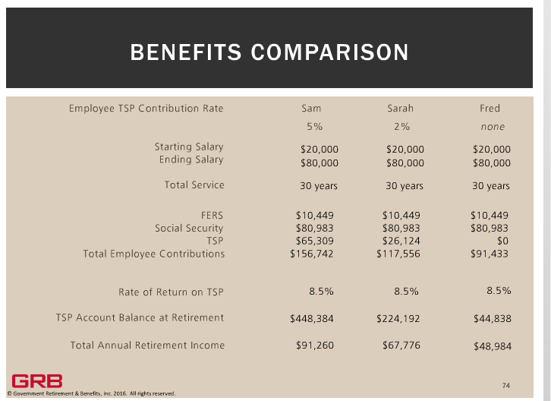
TSP Benefits Comparison
50
Notes:
This is an example of how contributing 5%, 3% or nothing to TSP over time can affect your balance and maybe your ability to financially afford to retire. It may seem insignificant now, but you may wish you had contributed more when you first started your career. TSP is the third leg of your retirement income.

Slide 51
Retirement
Full-time and part-time employees hired after 1983 are covered by Federal Employee’s Retirement System (FERS).
FERS is administered by the Office of Personnel Management
Participation is mandatory
FERS-FRAE:
New employees without prior federal civilian service hired after January 1, 2014
FERS-FRAE participants contribute 4.4% of basic pay each pay period to their retirement.
FERS-RAE:
Any individual who receives an appointment not excluded from FERS coverage on or after January 1, 2013.
FERS-RAE participants contribute 3.1% of basic pay each pay period to their retirement.
Agency contributes each pay period
Provides a monthly benefit called an annuity if you retire
For information visit https://www.opm.gov/retirement-services/fers-information/
51
Notes:
Federal Employee’s Retirement System (FERS) is mandatory for full and part time employees hired after 1983. FERS is administered by the Office of Personnel Management (OPM). New employees, without prior federal civilian service hired after 1/1/2014 are covered by FERS-FRAE. The contribution rate for FERS-FRAE employees is 4.4% per pay period and is mandatory, meaning you can not elect to stop it. There are other retirement coverages, related to FERS, with different suffixes and different deduction amounts based on when employees were hired. The Agency also contributes to your retirement each pay period. FERS is the first leg of your retirement income, once you retire. You can find more information regarding retirement on the OPM website.

Slide 52
GRB Platform 24/7 from Work or Home
The Government Retirement & Benefits (GRB) Platform connects you to your Federal Benefits 24/7. It is an easy-to-use enterprise system that is integrated with Personnel/Payroll systems, it can provide government employees with access to current information regarding government wide benefits programs such as:
Retirement
Thrift Savings Plan (TSP)
Health Insurance
Life Insurance
Dental & Vision Insurance
Flexible Spending Accounts
Social Security
Pay & Leave
Workers Compensation Benefits
52
Notes:
The Government Retirement & Benefits (GRB) Platform gives you access to information regarding your benefits, including retirement, FEHB, TSP, Social Security, etc. in one place. You can access the GRB Platform 24/7 from home or work, but you must access it from work the first time using your IRS email. As with other systems, you may need to wait a pay period to register for this system.

Slide 53
Accessing GRB Platform from work
Your GRB account will be accessible after you receive your first salary check. You must use your work computer to establish your GRB account the first time, then you will be able to access your account from your home devices.
From the IRS Source home page select Employee Resources
53
Notes:
From an IRS computer, you can access the GRB Platform through IRS Source, under the Employee Resources tab.

Slide 54
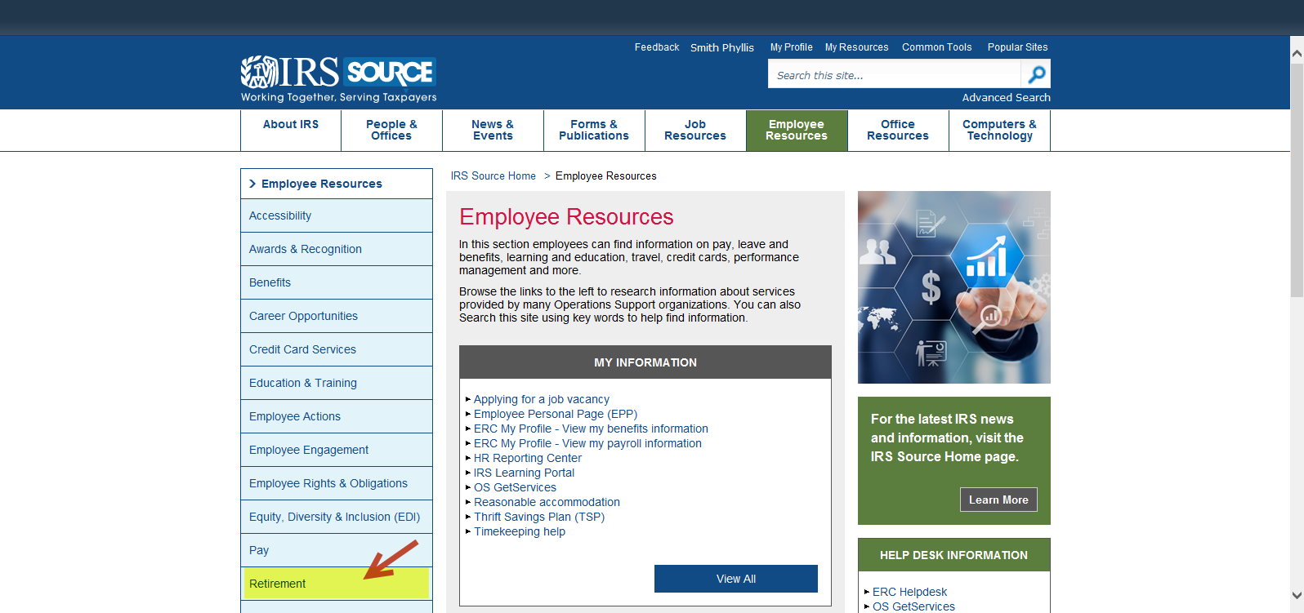
Accessing GRB Platform from Work
Select Retirement from the list of options
54
Notes:
Select Retirement on the left.

Slide 55
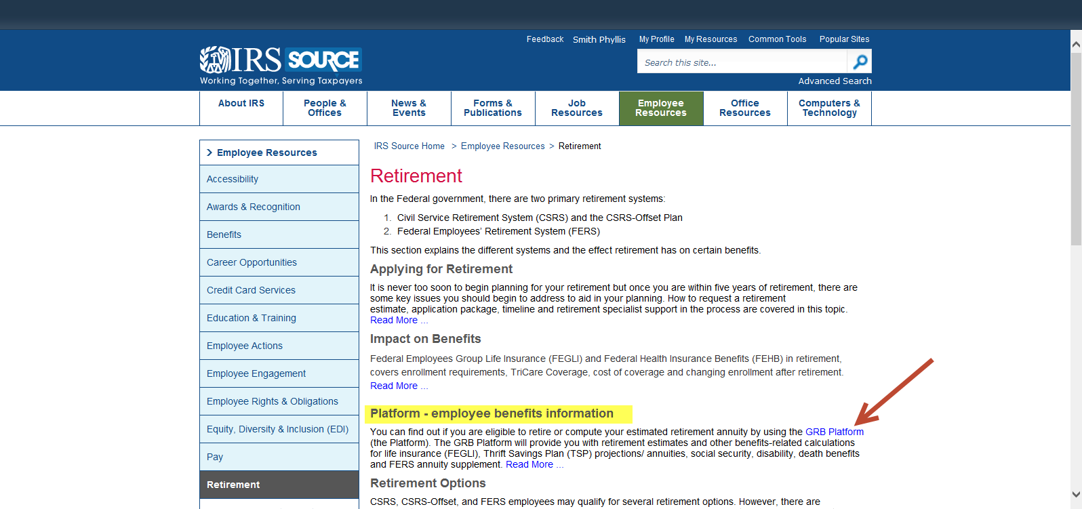
Accessing GRB Platform from Work
Select the GRB Platform link listed in the Platform-employee benefits information.
55
Notes:
From the GRB link in the center of the page, it will carry you directly to the registration/login page.

Slide 56
Narrowing Topic Choices
Input “GRB Platform in your search engine
Select GRB Platform:1.2.106.34 – Post-Sign In from the list of options
56
Notes:
The GRB Platform can also be located using Google. You input GRB Platform in the search and press enter. You may have to put in the license number for IRS if you access the GRB Platform this way.

Slide 57
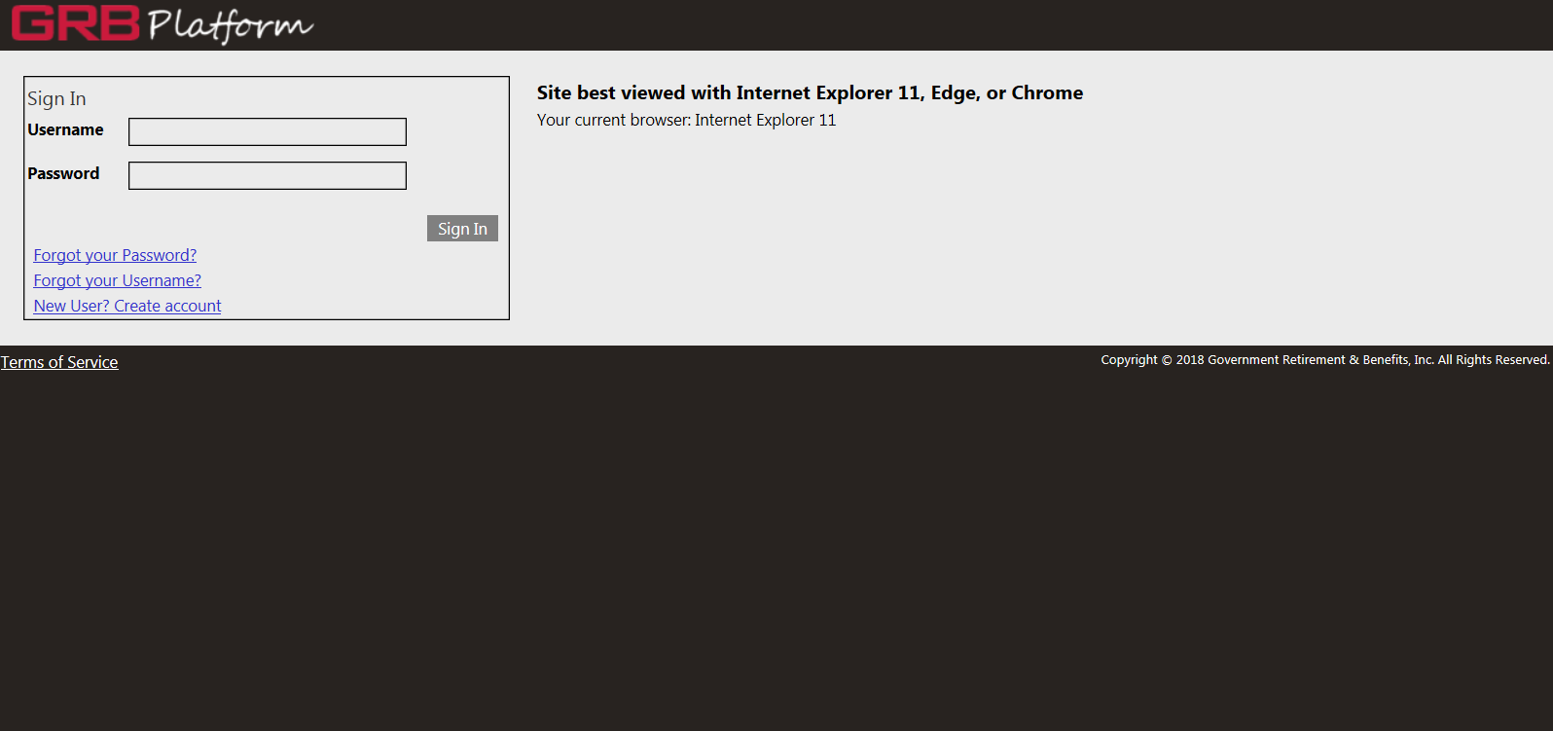
GRB Platform Login Page
Click on the New User? Create account link. You will be asked to verify your identity. You will need your:
Social Security Number
First Name
Last Name
Date of Birth
Work Email (@irs.gov)
You may also be asked to supply a license number. IRS’s license number is 1112
57
Notes:
When using the GRB platform for the first time, you need to register using the New User? Create account link. As stated earlier, you will need to have your IRS email to register.

Slide 58
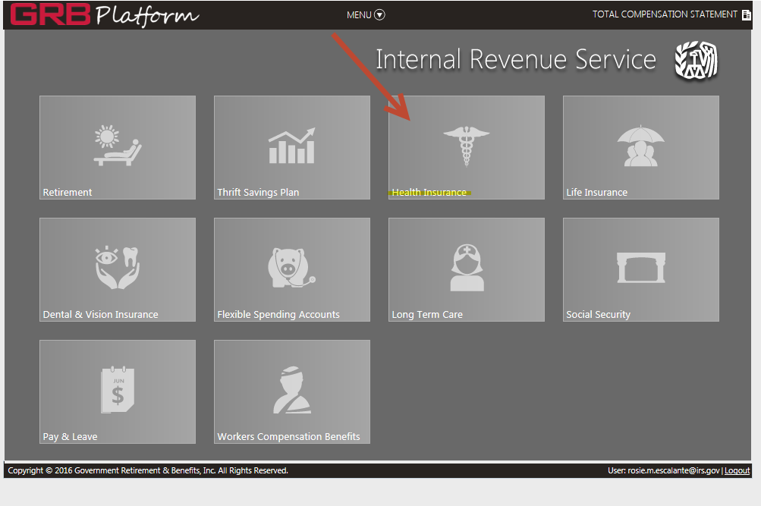
Landing Page
After logging into the GRB Platform you initially arrive at the “Landing Page”, here you will see several tiles with each tile representing a specific federal benefit program
To access information about a federal benefit program simply click the tile and it will expand to fill the window
58
Notes:
Once you are logged into the GRB Platform, you will see your options on the landing page. You will be able to select the individual tile for the applicable information.

Slide 59
Additional Features
To access the additional features in the GRB Platform, just click on the drop-down menu at the top of GRB and the menu window will appear
59
Notes:
You can also submit requests for retirement through the GRB Platform using the menu option.

Slide 60
Videos, Documents, Forms, Links
To view any videos, documents, forms or external links in the GRB Platform you can go to the “Resource Library” on the Menu window
The GRB Platform provides information (e-seminar) videos such as:
Retirement for FERS or CSRS Employees
Retirement for Special Group Employees (Law Enforcement)
FEDVIP (Dental & Vision)
Life Insurance
Health Insurance
Medicare
Long Term Care Insurance
Flexible Spending Accounts
TSP
Social Security
Financial Planning
New Employee Benefits Orientation
or the “Resources” area on the benefit tiles
60
Notes:
There are several informational videos available, including a supplemental New Hire Orientation, located in the Resources portion of the GRB Platform.

Slide 61
State Tax Withholding
State Tax is withheld based on an employee’s duty station. Not an employee’s resident state. However, some states may have reciprocal agreements with nearby states, which allow employees to waive the duty station withholding and withhold based on their state of residence.
To change your state tax withholding from one state to another, a paper state tax withholding form must be completed and forwarded to the IRS Philadelphia Payroll Center for Processing.
Fax: 855-207-0459 Attn: IRS Payroll Center, Admin Payroll Branch
Email: HCO.PPSP.PHI.ACCESSIONS@IRS.Gov
To obtain the form, contact Payroll & Benefits at 866-743-5748, option 1 for ERC and then option 3 for Payroll & Benefits
61
Notes:
If you live in an area with state tax withholding, the withholding rate is based on your duty location, not your resident state. Some states have reciprocal agreements with nearby states which allows employees to waive the duty station withholding and have their state of residence tax withheld. A paper form will need to be completed and sent to the Philadelphia Payroll Center to make this change, by fax or email.

Slide 62
Transferring from Another Federal Agency
If you are transferring from another federal Agency, you can submit your last Statement of Earnings and Leave for expedited service regarding the transfer of leave balances or FEHB coverage, if your SF-75 information has not been processed.
LEAVE
Data Integrity Office
Fax: 855-875-6605 or
Email: opf.con.site@irs.gov
FEHB
Benefits Unit
Fax: 855-816-9805
Email: ogden.benefits.section@irs.gov
62
Notes:
If you transferred from another Agency, you can submit your last Statement of Earnings and Leave for expedited service regarding the transfer of leave balances or FEHB coverage, if your SF-75 information has not processed.

Slide 63
Prior Service
Prior Active-Duty Military Service: Go to www.opm.gov and fill out the form RI-20-97.
https://www.opm.gov/forms/pdf_fill/ri20-97.pdf
Prior Federal Civilian Service – If you have prior federal service but are NOT a transfer, please allow up to 60 days for your records to be updated (SCD/Leave Category).
63
Notes:
Please allow up to 60 business days for prior service information to be updated in the payroll systems. Currently, this may take up to 120 business days. Prior active-duty military service needs to have the RI-20-97 completed and submitted as well. You can obtain this form from the OPM website.

Slide 64
Military Deposit Process
To start the process of paying your military deposit, you must first:
Request your Estimated Earnings During Military Service by completing Form RI 20-97 and send along with a copy of your DD214(s) directly to your applicable Branch of Service
When your estimate is received, access the GRB Platform upload the information and request a Military work up. You will then get your deposit amount, and comparative estimates to determine whether it is worth it to pay the deposit
Interest on the deposit amount begins to accrue two years from the date you are covered by FERS, so it is financially prudent to pay it at the beginning of your career rather than at the end
Please note this entire process may take several months, so please be sure to do this well in advance of retirement since the deposit MUST be made in full for Post 56 Military Service before credit can be given for SCD-Retirement and Annuity
(For addresses to your applicable Branch of Service contact ERC at 1-866-743-5748, Option 1)
64
Notes:
To make a military deposit, you must first request your estimated earnings, for your military service, from your branch of service. You can contact the Customer Service Line at ERC for the address of the applicable branch of service. Once you receive this information from the Military, you will submit the information through the GRB Platform by uploading the form and requesting a military workup. When the workup is complete, you will receive the deposit amount, along with comparative estimates to determine if making the deposit is worth while for you or not. Interest on the deposit amount begins to accrue 2 years from the date you are covered by FERS, so paying this at the beginning rather than at the end of your career is financially prudent. This process can take several months, so be sure to do this well in advance of retirement since the deposit MUST be made in full for Post 56 Military Service to be credited for Service Computation Date-Retirement and annuity purposes.

Slide 65
How Can You Reach Us?
For Assistance call:
1-866-743-5748
1-800-877-8339 Federal Relay Service
Call Center Hours of Operation
Gate | Monday | Tuesday | Wednesday | Thursday | Friday
Payroll & Benefits Gate | 8:00a – 6:00p (ET) | 8:00a – 6:00p (ET) | CLOSED | 8:00a – 6:00p (ET) | CLOSED
Timekeeping / SETR Gate | 8:00a – 6:00p (ET) | CLOSED | CLOSED | 8:00a – 6:00p (ET) | 8:00a – 6:00p (ET)
On-line at:
OS GetServices
http://getservices.web.irs.gov/
65
Notes:
You can reach the Customer Assistance Line at the Employee Resource Center by dialing 866-743-5748 option 1, then option 3 for Payroll. Our hours of operation are Monday, Tuesday, and Thursday 8a-6p EST, 7a-5p CST, 6a-4p MST, 5a-3p PST. Our phone line is unavailable on Wednesdays and Fridays to address outstanding OS GetService requests and other core work.. Memphis Payroll can be reached Monday, Thursday, and Friday, 8a-6p EST, 7a-5p CST, 6a-4p MST, 5a-3p PST. Their phones are unavailable 2nd Monday 1p-6p EST, 12p-5p CST, 11a-4p MST, 10a-3p PST, all day Tuesday and Wednesday.

Slide 66
Resources
GRB Platform - https://platform.grbinc.com
Employee Resource Center (ERC) -1-866-743-5748, Option 1
Office of Personnel Management (OPM) - www.opm.gov
Thrift Savings Plan – www.tsp.gov
Social Security – www.ssa.gov
Flexible Spending Account (FSA) – www.fsafeds.com
Dental and Vision via the Federal Employees Dental and Vision Insurance Program (FEDVIP) - www.benefeds.com
66
Notes:
Additional resources we discussed today are listed here along with the link to access them.

Slide 67
67
Notes:
Again, Welcome to the Internal Revenue Service. We know this was a lot of information in a short period of time, so please write down any questions and we will answer them during the scheduled Q&A session.

